Slide 1
MINIMIZING PAID ADVERTISING COSTS BY PREDICTING THE USERS WHO ARE LIKELY TO SUBMIT A LEAD FORM
Prepared By : TACETTIN ARICI

Slide 2

Table of Contents
Data and Problem Understanding
Exploratory Data Analysis
Model and Prediction
Results

Slide 3

Data and Problem Understanding
Visited website and tried to Lead Form
Name
Are you currently an X client?
How many employees do you have?
What’s the name of your organization?
Where are you located?
Contact information to share pricing.
Email
Phone
Other data like web logs collected.

Slide 4
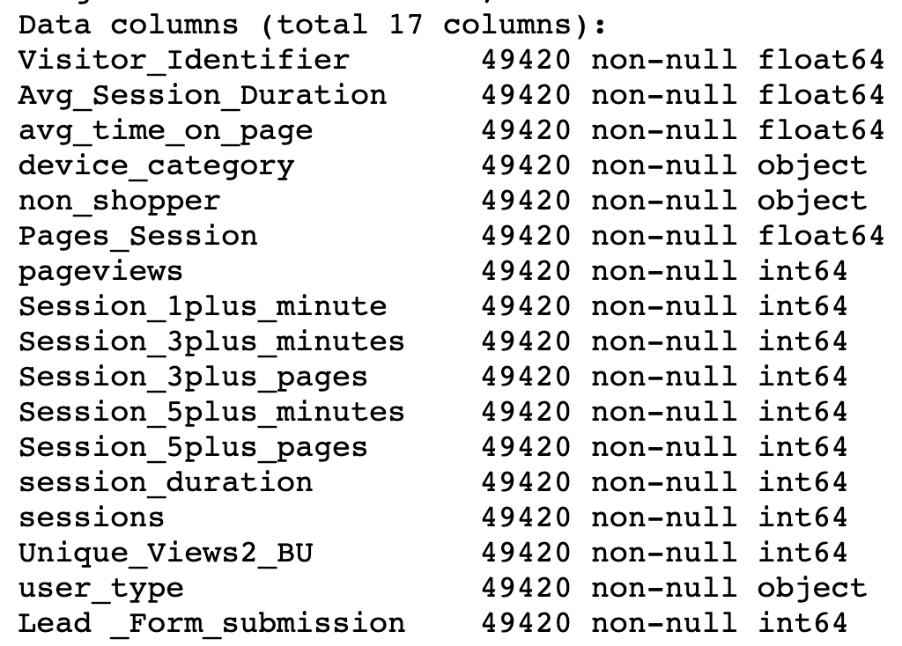
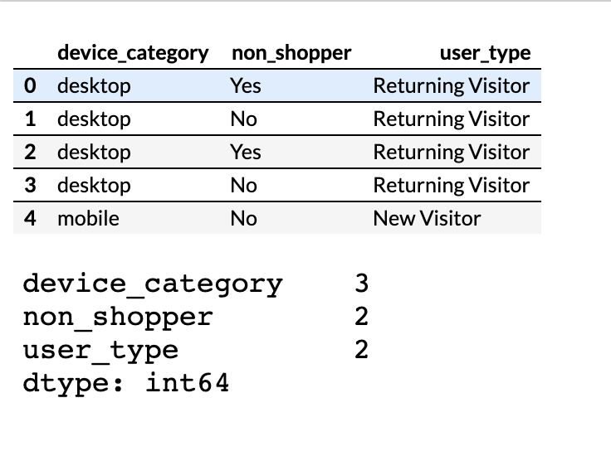
Data and Problem Understanding
One Hot Encoding by get dummies
- Shape - Null Values
- Categorical - Numeric

Slide 5
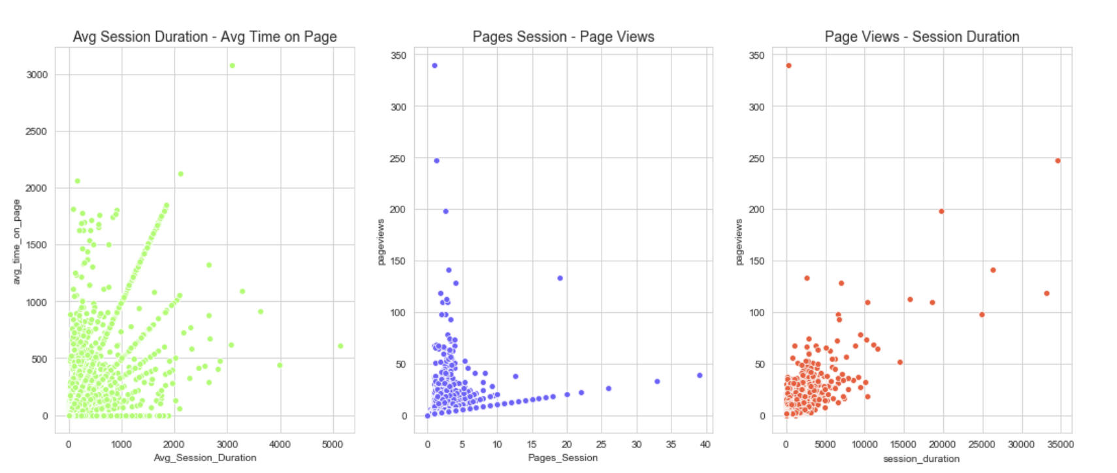
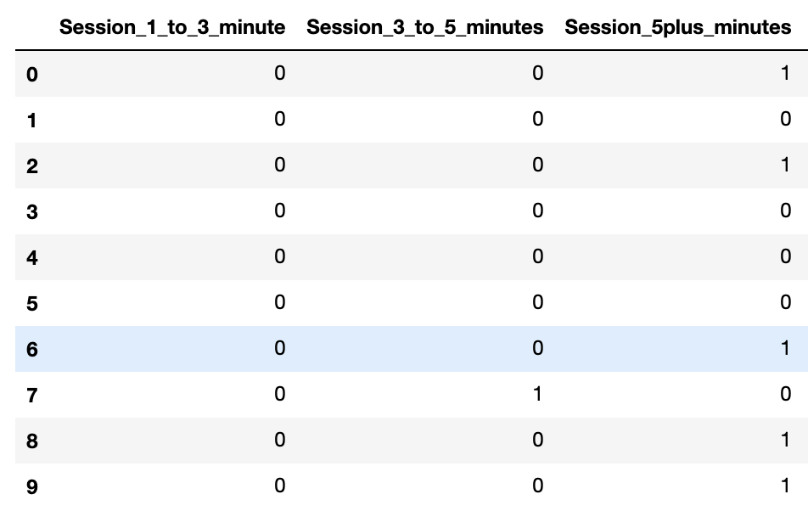
Data and Problem Understanding
OUTLIERS
Z-Score, IQR* values and visualizations to
detect outliers.
* Interquartile range outliers
MINUTES and PAGES
Eliminated over counting when higher minutes-pages columns are present

Slide 6
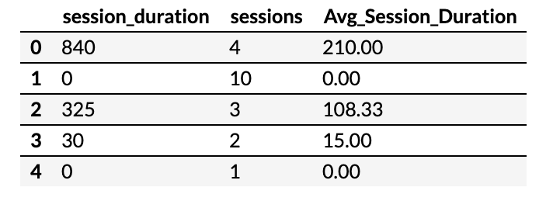
Exploratory Data Analysis
Feature Investigation
Avg time on page, Session duration, Sessions
Avg Session Duration is created by dividing session duration to sessions
Pages Session, Pageviews, Sessions
Pages Session is created by dividing pageviews to sessions
Purpose : to prevent information replication. Drop sessions

Slide 7
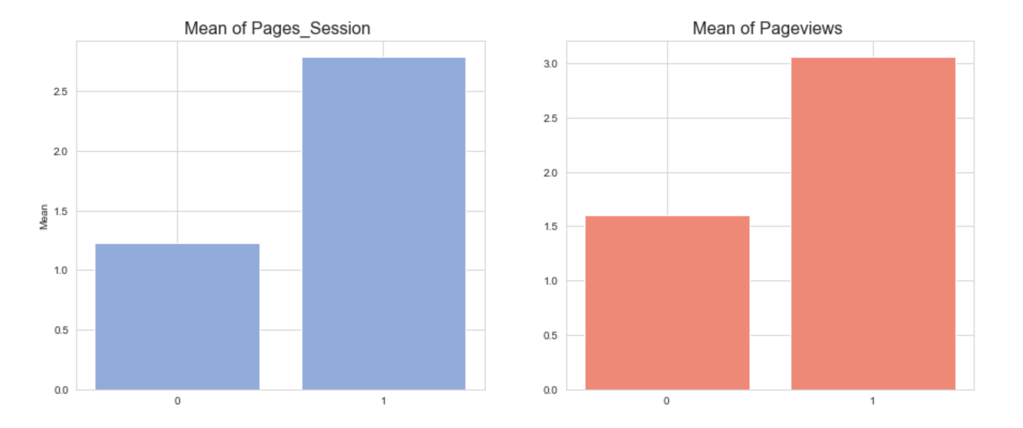
Exploratory Data Analysis
Relation of Pages Session and Page views with Lead Form Submission
Higher the mean, higher the chance to Lead Form

Slide 8
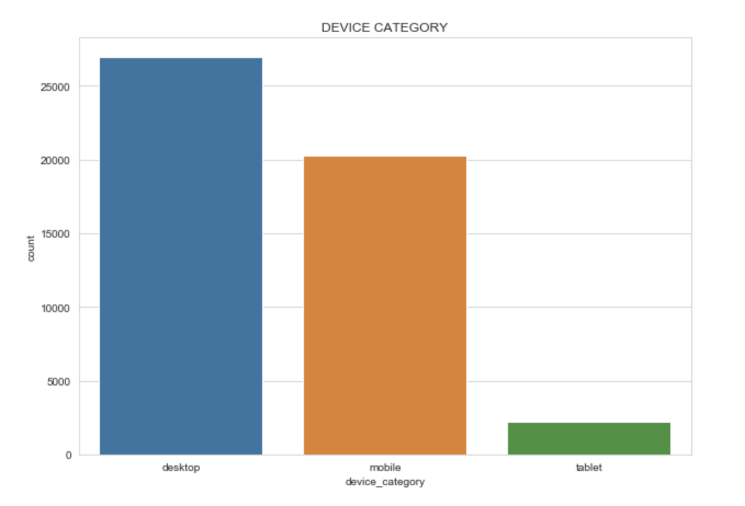
Exploratory Data Analysis
Device Category
desktop = % 0.039
mobile = % 0.032
tablet = % 0.034
Mobile is important,
but percentage is almost same.

Slide 9
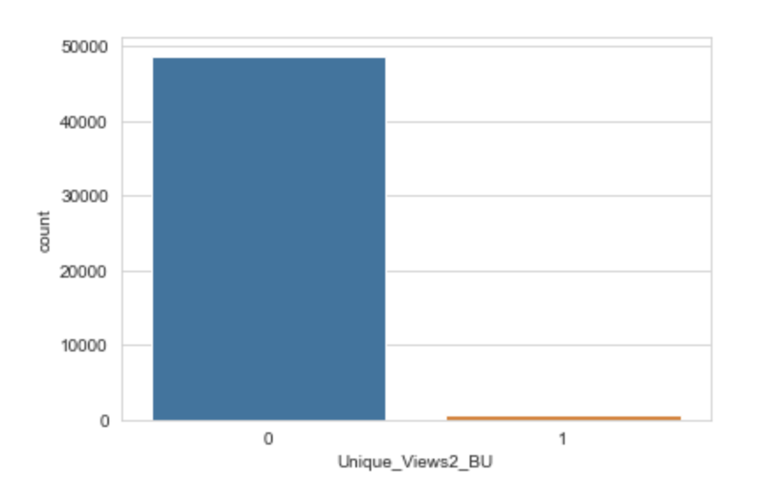
Exploratory Data Analysis
Business Unit
If BU Content Group is `0`
the chance that customer submit form is around `3.65%`
If BU Group is `1` the
chance that customer submit form increases up to `20%`

Slide 10
Exploratory Data Analysis
MULTICOLLINEARITY
Decision trees and boosted trees algorithms are immune to multicollinearity by nature.
When they decide to split, the tree will choose only one of the multicollinear features
SCALING
Standard Scaling is implemented
Even if Tree based models are not distance based models and can handle varying ranges of features, data is scaled for Logistic Regression
PCA
Feature Number is already good enough, no needed PCA.
Applied to see its effect on models and understand if couple of components can represent variation of data

Slide 11
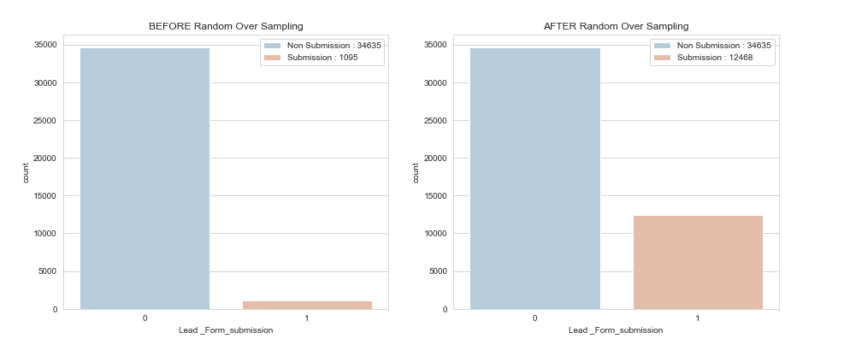
Prediction
Random Over Sampling for Imbalance Problem
Target value clearly shows us there is an important Imbalance problem in this data set. To fix this issue, applied Random Over Sampler

Slide 12
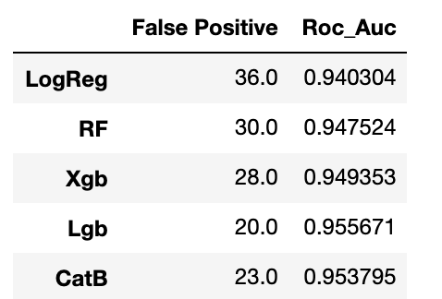
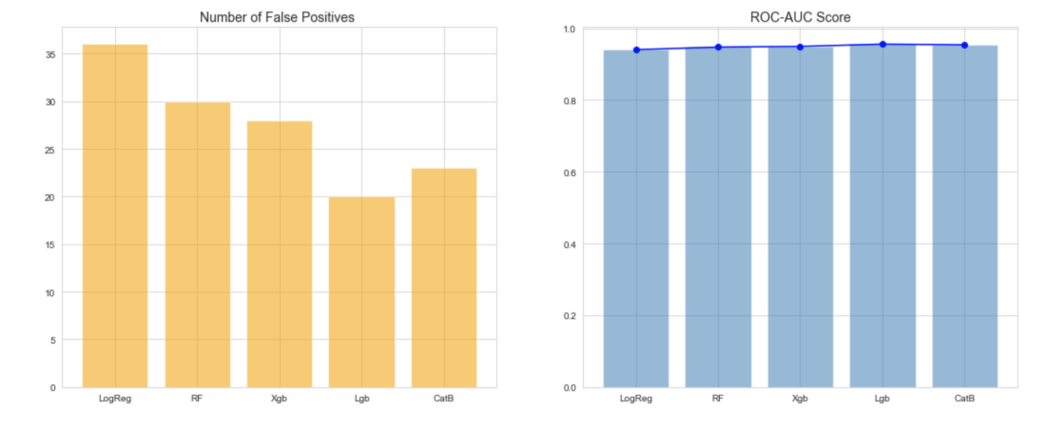
Prediction
My purpose is to Minimizing Paid Advertising Costs by Predicting the users who are likely to submit a lead form
To this aim False Positives will be metrics along side ROC-AUC score.

Slide 13
Conclusion
Performed data pre-processing to increase the prediction rate of who will be a customer.
Fixed imbalanced problem by applying Random Over Sampling​ In the supervised learning part.
​​Models did a decent job in this step and got the decent ROC-AUC score of 0.95.
All models worked well but Light GBM works a bit better than others.
The impact of using machine learning for such kind of reducing advertising cost is important.

Slide 14
Improvement
I think further fine tuning the model will help to improve prediction performance further.
More Features can contribute to increase prediction rate.

Slide 15
Thanks For Listening Me
Tacettin ARICI

